Slide 1

Python • Pandas • Seaborn • Scikit-learn
Data Analysis & Machine Learning Project

Slide 2
1. Complete Data Analysis Flow
From raw data to regression prediction
Load Dataset
Energydata.csv
Clean Data
Missing + Duplicates
Feature Engineering
Date → Year / Month / Hour / Day
EDA
Correlation • Heatmap
• Boxplot • Skewness
Train / Test
80% / 20%
Feature Selection
Correlation > 0.05
Regression
LR • DT • RF • GB
Evaluation
MAE • MSE • RMSE • R²
Best Model
Gradient Boosting
12

Slide 3
2. Project Overview
What are we trying to solve?
Problem
Objective
Target
Energy consumption changes with appliance usage, temperature, humidity and time.
Analyze the energy dataset and build regression models to predict appliance energy.
ApplianceEnergy is the target variable we want to predict.
• Understand the dataset
• Clean and prepare the data
• Find relationships and important features
• Compare regression algorithms
2

Slide 4
3. Dataset Description
Initial understanding of the energy data
Records
Original Features
Target
19,735 rows
29 columns
Appliances / ApplianceEnergy
• Energy-related variables include appliance energy, lights, temperature and humidity.
• Weather variables include outdoor temperature, pressure, wind speed, visibility and dew point.
• Date information is converted into useful time features such as year, month, hour and day of week.
3

Slide 5
4. Data Preprocessing
Making the data ready for analysis
Load
Clean
Transform
Feature Engineering
Prepare
Read Energydata.csv
Check missing values
& duplicates
Convert Date to datetime
Create year, month, hour,
day_of_week
Separate X and y
• Missing-value check: no missing values were found in the original dataset.
• Duplicate check: 0 duplicate rows were found.
4

Slide 6
5. Exploratory Data Analysis
Understanding patterns before modelling
Descriptive Statistics
Correlation
Outliers
Mean, standard deviation, minimum, maximum and quartiles.
Correlation matrix and heatmap were used to study relationships.
Boxplots were used to identify extreme values.
• ApplianceEnergy has a mean of about 97.69 and a maximum of 1080 in the original data.
• Skewness was calculated to understand whether numerical features are symmetric or highly skewed.
• IQR-based outlier treatment was explored in the notebook.
5

Slide 7
6. Correlation & Feature Analysis
Finding variables related to appliance energy
Correlation Insight
Hour has a positive relationship with appliance energy (about 0.217).
Feature Selection
Features with absolute correlation above 0.05 were selected in the notebook.
Important note
Correlation shows association, not causation.
6

Slide 8
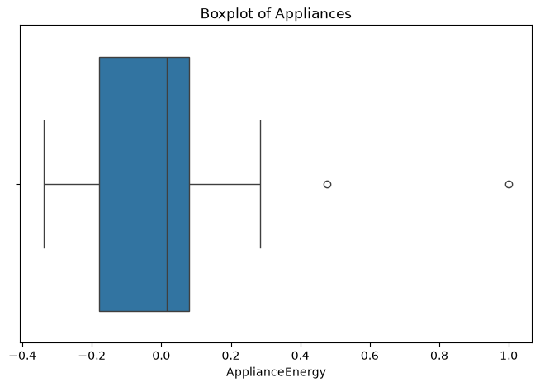
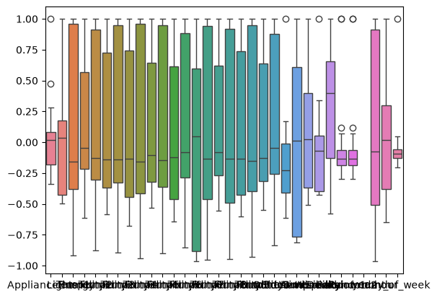

7. Outlier Analysis – Boxplots
Actual plots from the notebook
Appliance Energy
Before IQR treatment
After IQR treatment
def fix_outliers_iqr(df):
num = df.select_dtypes(include='number').columns
for col in num:
Q1 = df[col].quantile(0.25)
Q3 = df[col].quantile(0.75)
IQR = Q3 - Q1
lower = Q1 - 1.5*IQR
upper = Q3 + 1.5*IQR
df[col] = df[col].clip(lower, upper)
return df
Why outlier analysis?
• Detect extreme values
• Reduce their influence on models
• Compare before/after distributions
14

Slide 9
8. Train–Test Split & Scaling
Preparing data for machine learning
Input (X)
Target (y)
Split
Predictor variables such as temperature, humidity, weather and time features.
ApplianceEnergy — the value to predict.
80% training data and 20% testing data.
• train_test_split() is used with random_state = 42.
• StandardScaler is prepared to standardize the training and test features.
• Scaling is especially useful for algorithms that are sensitive to feature magnitude.
7

Slide 10
9. Model Evaluation Metrics
How do we judge the predictions?
MAE
MSE
RMSE
R²
Average absolute prediction error
Average squared prediction error
Square root of MSE; error in target scale
How well the model explains target variation
Lower is better
Lower is better
Lower is better
Higher is better
RMSE = √MSE
9

Slide 11
10. Regression Algorithms
Four models are compared
Linear Regression
Decision Tree
Simple linear relationship
Rule-based non-linear model
Random Forest
Gradient Boosting
Many decision trees combined
Sequential trees that improve errors
• Goal: choose the model with lower error and higher R² score.
8

Slide 12
11. Model Performance Results
Results recorded in the notebook
Model | MAE | MSE | RMSE | R²
Linear Regression | 0.06 | 0.01 | 0.11 | 0.82
Decision Tree | 0.03 | 0.00 | 0.05 | 0.95
Random Forest | 0.05 | 0.01 | 0.07 | 0.92
Gradient Boosting | 0.04 | 0.00 | 0.05 | 0.96
Best R²: Gradient Boosting (0.96)
10

Slide 13
10. Conclusion
What did we learn?
• Python provides a complete workflow for energy data analysis — from cleaning to prediction.
• Exploratory analysis helps understand correlations, skewness and outliers before modelling.
• Four regression algorithms were compared using MAE, MSE, RMSE and R².
• Gradient Boosting achieved the highest R² score in the recorded results (0.96).
• Therefore, Gradient Boosting is the preferred model among the four tested models in this notebook.
11

Slide 14
THANK YOU
Questions & Discussion
Energy Data Analysis • Regression Prediction

